Slide 1
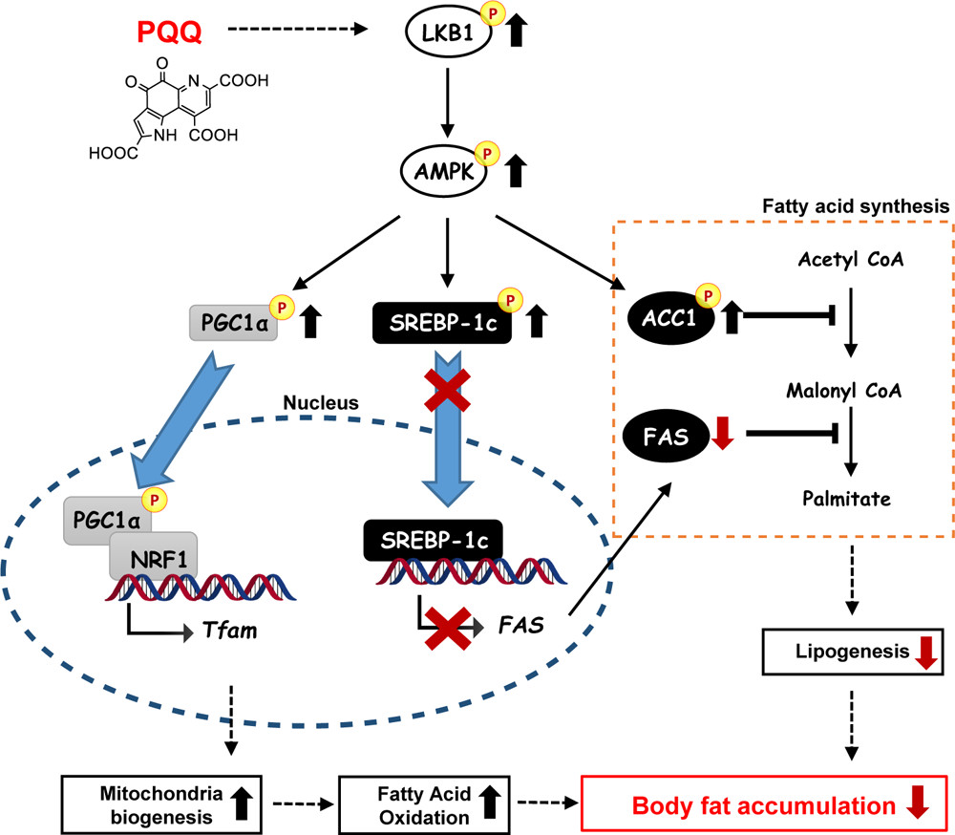
“Proposed molecular mechanism of PQQ action in reducing fat accumulation”
Mohamad Ishak et al., ACS Food Sci. Technol. 2021, 1, 10, 1979–1989、Figure 6を転載．©2021 The Authors. Licensed under CC BY-NC-ND 4.0
PQQによる脂肪減少の分子機構

