Slide 1
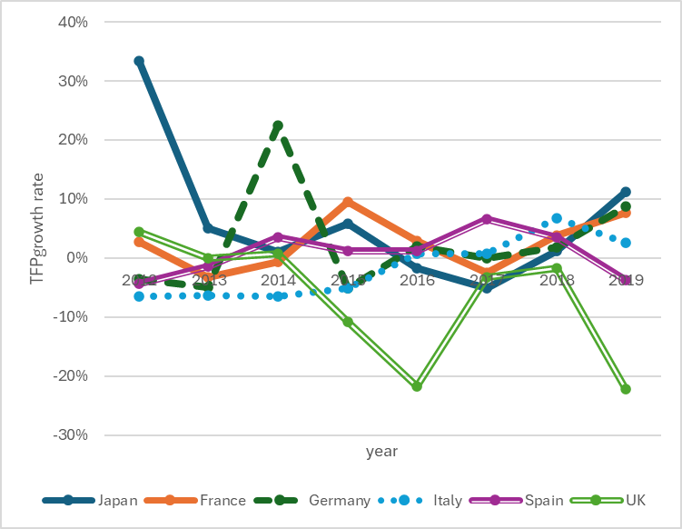
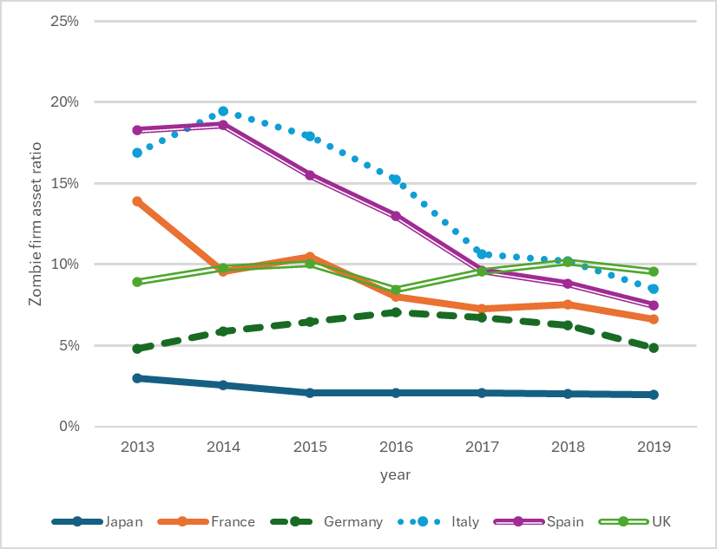
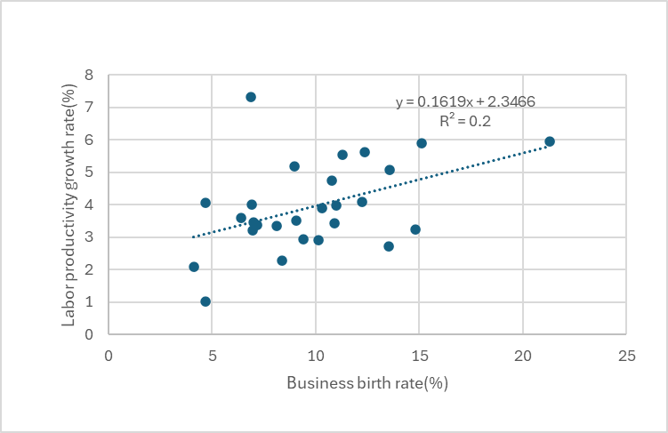
Do SMEｓ and Zombie firms cause the stagnation of the Japanese economy?
～Cross country evidence from Japan and five European countries（FN,GM,IT,SP,UK）～
Zombie firms may be a barrier to entry for young firms and an obstacle to
metabolism, thus contributing to the long-term stagnation of Japan.
What is the cause of Japan’s economic stagnation?
We explore the relationship between A and B by corporate financial panel data(Orbis DB）
The SMEs are not a cause of Japan’s unique slump.
ig. 2. Zombie firat ratio(2013～2019)
Japan’s Zombie firms create barriers to entry
Source: Orbis DB
Fig. 1. TFP growth rate by country(2012～2019)
Source: Orbis DB
A: dependent variables
Capital investment
Growth in the number of employees
TFP(Total Factor Productivity)
B: independent variables
Firm size
Zombie factor etc.
Non-Zombie
Zombie dummy
Young dummy
Fig. 2. Zombie firm asset ratio(2013～2019)
Japan
Source: OECD.Stat EU. Stat and others
※Japan's TFP is comparable to five European countries, but interestingly, Japan has the lowest Zombie asset ratio.
Fig.3. Business birth rates and Labor productivity growth rate
Yoshiyuki Kitano and Yoshiaki Shimizu (2025) DOI

